Slide 1
AZ-400.00 Module 5: Implementing Continuous Integration with Azure Pipelines

Slide 2
Lesson 01: Module overview

Slide 3
Module overview (1/2)
Lesson 1: Module Overview
Lesson 5: Agent Pools
Lesson 2: The concept of Pipelines in DevOps
Lesson 6: Pipelines and Concurrency
Lesson 3: Azure Pipelines
Lesson 7: Azure DevOps and Open Source Projects (Public Projects)
Lesson 4: Evaluate use of Hosted vs Private Agents
Lesson 8: Azure Pipelines YAML vs Visual Designer

Slide 4
Module overview (2/2)
Lesson 9: Continuous integration overview
Lesson 13: Set up private agents
Lesson 10: Implementing a build strategy
Lesson 14: Analyze and integrate docker multi-stage builds
Lesson 11: Integration with Azure Pipelines
Lesson 15: Labs
Lesson 12: Integrate external source control with Azure Pipelines
Lesson 16: Module review and takeaways

Slide 5
Learning objectives
After completing this module, students will be able to:
Implement and manage build infrastructure
Explain why continuous integration matters
Implement continuous integration using Azure DevOps

Slide 6
Lesson 02: The concept of pipelines in DevOps

Slide 7
The concept of pipelines in DevOps
Build Automation and Continuous Integration
Test Automation
Deployment Automation
A pipeline enables a constant flow of changes into production via an automated software production line
Pipelines create a repeatable, reliable and incrementally improving process for taking software from concept to customer
Pipelines require infrastructure, this infrastructure will have a direct impact on the effectiveness of the pipeline

Slide 8

Lesson 03: Azure Pipelines

Slide 9
Azure Pipelines
Azure Pipelines is a cloud service that you can use to automatically build and test your code project and make it available to other users
Works great with Continuous Integration and Continuous Delivery:
Work with any language or platform – Python, Java, PHP, Ruby, C#, and Go
Deploy to different types of targets at the same time
Integrate with Azure deployments – Container registries, virtual machines, Azure services, or any on-premises or cloud target (Microsoft Azure, Google Cloud, or Amazon cloud services)
Build on Windows, Linux, or Mac machines
Integrate with GitHub
Work with open-source projects
Notes:
Review the Azure Pipelines Key terms in the student manual.

Slide 10
Azure key terms
Agent
Job
Artifact
Pipeline
Build
Release
Continuous Delivery
Task
Continuous Integration
Trigger
Deployment Target

Slide 11

Lesson 04: Evaluate use of Hosted Vs Private Agents

Slide 12
Microsoft vs Self-Hosted Agents
You need at least one agent to build or deploy your project
An agent is installable software that runs one build or deployment job at a time
Two types of agents:
Microsoft-hosted agents – Automatically take care of maintenance and upgrades. Each time you run a pipeline; you get a fresh virtual machine. The virtual machine is discarded after one use
Self-hosted agents – You take care of maintenance and upgrades. Give you more control to install dependent software needed. You can install the agent on Linux, macOS, Windows machines, or even in a Linux Docker container

Slide 13

Lesson 05: Agent Pools

Slide 14
Agent Pools
Pool A
Pool B
Machine
Machine
Agent
Agent
Agent
Agent
Agent
You can organize agents into agent pools
An agent pool defines the sharing boundary
In Azure Pipelines, agent pools are scoped to the Azure DevOps organization; so you can share an agent pool across projects
Notes:
Use the student manual for some typical situations where you might want to create agent pools.

Slide 15
Default Agent Pools
Default pool – For self-hosted agents
Hosted VS2019 pool
Hosted VS2017 pool
Hosted Ubuntu 2004 pool
Hosted Ubuntu 1804 pool
Hosted Ubuntu 1604 pool
Hosted macOS 1014 pool
Hosted macOS 1015 pool

Slide 16
Typical situations for Agent Pools
You’re a member of a project and you want to use a set of machines owned by your team for running build and deployment jobs
You’re a member of the infrastructure team and would like to set up a pool of agents for use in all projects
You want to share a set of agent machines with multiple projects, but not all of them
On-premises Team Foundation Server or VisualStudio.com account
Pool A
Pool B
Machine
Machine
Agent
Agent
Agent
Agent
Agent
Queue 1
Queue 2
Queue 1
Team Project Collection A
Team Project Collection B
Team Project A1
Team Project A2
Team Project B1
Build definition 1
Build definition 3
Build definition 1
Build definition 2
Build definition 4
Build definition 2

Slide 17
Security of Agent Pools
Roles are defined on each agent pool, and membership in these roles governs what operations you can perform on an agent pool
Role | Purpose
Reader | Members of this role can view the organization agent pool as well as agents. You typically use this to add operators that are responsible for monitoring the agents and their health
Service Account | Members of this role can use the organization agent pool to create a project agent pool in a project. If you follow the guidelines above for creating new project agent pools, you typically do not have to add any members here
Administrator | In addition to all the above permissions, members of this role can register or unregister agents from the organization agent pool. They can also refer to the organization agent pool when creating a project agent pool in a project. Finally, they can also manage membership for all roles of the organization agent pool. The user that created the organization agent pool is automatically added to the Administrator role for that pool

Slide 18
Lesson 06: Pipelines and concurrency

Slide 19
Microsoft-Hosted vs Self-Hosted
A free tier of service by default for every organization
Service is based on public vs private projects
Microsoft-hosted CI/CD
Run your builds and releases on machines that Microsoft manages
Jobs run on the pool of hosted agents
There are time limits on these jobs
Self-hosted CI/CD
Azure Pipelines orchestrates your builds and releases
Use your own machines to run the builds and releases
There are no time limits on these jobs

Slide 20
Parallel jobs
FabrikamFiber CI Build 102 (master)
1
FabrikamFiber Release 11
2
5
FabrikamFiber CI Build 101 (feature)
3
4
Queued build waiting for pipeline
Build running
Release waiting for pipeline
Release running
Release waiting for approval
This is a simple example of a Microsoft-hosted parallel job
Users can collectively run only one build or release job at a time, additional jobs are queued
A release consumes a parallel job only when it’s being actively deployed to a stage

Slide 21
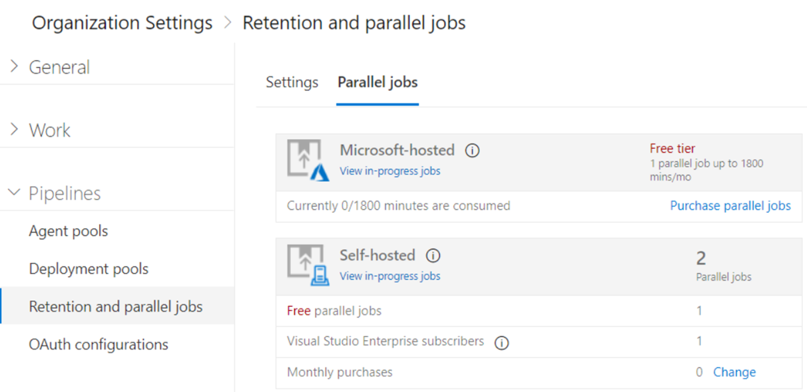
Estimating parallel jobs
Determine how many parallel jobs you need
Simple estimates vs Detailed estimates
You can display all the builds and releases
Parallel jobs are purchased at the organization level, and are shared by all projects

Slide 22
Lesson 07: Azure DevOps and open source projects

Slide 23
Azure DevOps and open source projects
How do I qualify for the free tier of public projects?
Are there limits on who can use Azure Pipelines?
Are there any limits on the number of builds and release pipelines that I can create?
As a Visual Studio Enterprise subscriber, do I get additional parallel jobs for TFS and Azure Pipelines?
What about the option to pay for hosted agents by the minute?

Slide 24
Lesson 08: Azure pipelines YAML vs visual designer

Slide 25
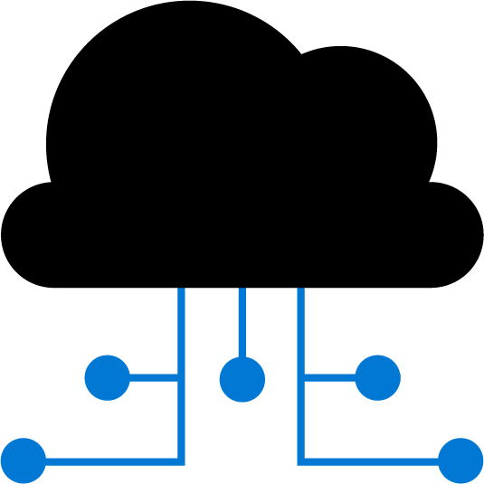
Azure pipelines and YAML
Configure your pipelines in a YAML file that exists alongside your code
Edit Code
Edit YAML file
Push to code repo
Azure Pipelines
Deploy to target
Configure Azure Pipelines to use your Git repo
Edit your azure-pipelines.yml file to define your build
Push your code to your version control repository
Your code is now updated, built, tested, and packaged

Slide 26

Azure pipelines and visual designer
Configure your pipelines with the Visual Designer
Continuous Integration
Continuous Deployment
Edit Code
Push to code repo
Build tasks
Test tasks
Create artifact
Release tasks
Deploy to target
Create and configure your build and release pipelines
Push your code to your version control repository
The build creates an artifact that’s used by the rest of your pipeline
Your code is now updated, built, tested, and packaged

Slide 27

Lesson 09: Continuous integration overview

Slide 28
Introduction to continuous integration
Continuous Integration (CI) is the process of automating the build and testing of code
CI encourages developers to share their code and unit tests by merging their changes into the shared version control repository
When a change is detected it triggers an automated build system. The code is built using a build definition. Developers respond to any issues or bugs
CI keeps the master branch clean ensuring bugs are caught earlier in the development cycle, which makes them less expensive to fix

Slide 29
The four pillars of continuous integration
Continuous Integration
Version Control System
Package Management System
Continuous Integration System
Automated Build Process
A Version Control System manages changes to your source code over time
A Package Management System is used to install, uninstall and manage software packages
A Continuous Integration System merges all developer working copies to a shared mainline several times a day
An Automated Build Process creates a software build including compiling, packaging, and running automated tests
Notes:
Cover the software examples shown in the student materials.

Slide 30
Benefits of continuous integration
Improving code quality based on rapid feedback
Triggering automated testing for every code change
Reducing build times for rapid feedback and early detection of problems (risk reduction)
Better management of technical debt and code analysis
Reducing long, difficult, and bug-inducing merges
Increasing confidence in codebase health long before production deployment
Rapid feedback to the developer
Notes:
✔️ Continuous integration also enables tracking metrics to assess code quality over time, such as unit test pass rates, code that breaks frequently, code coverage trends, and code analysis. It can be used to provide information on what has been changed between builds for traceability benefits, as well as for introducing evidence of what teams do in order to have a global view of build results.
For more information, you can see: What is Continuous Integration? - https://docs.microsoft.com/en-us/azure/devops/learn/what-is-continuous-integration

Slide 31

Discussion: Continuous integration
Have you tried to implement continuous integration in your organization?
If you where successful, what lessons did you learn?
If you were not successful, what were the challenges?

Slide 32
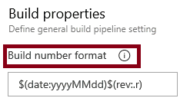
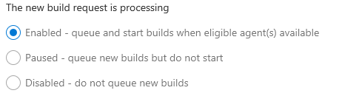
Build number formatting and build status
Build number formatting
Build status (enabled, paused, disabled)

Slide 33
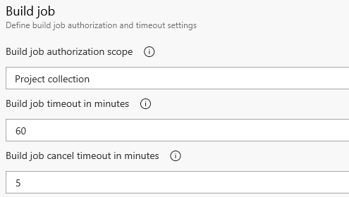

Authorization and timeouts, and badges
Authorization and Timeouts (scope, job timeout, cancel job timeout)
Badges
Notes:
For more information, you can see:
Build Pipeline Options - https://docs.microsoft.com/en-us/azure/devops/pipelines/build/options?view=vsts&tabs=yaml

Slide 34

Lesson 10: Implementing a build strategy

Slide 35
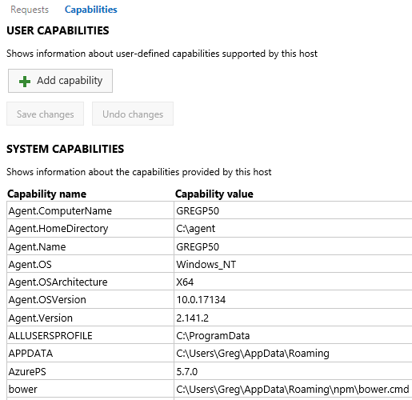
Configuring agent demands
User Capabilities
System Capabilities
Agents can have different authorization and timeout settings
Notes:
For more information, you can see: Capabilities - https://docs.microsoft.com/en-us/azure/devops/pipelines/agents/agents?view=vsts#capabilities

Slide 36

Implementing multi-agent builds
Adding multiple jobs to a pipeline lets you:
Break your pipeline into sections that need different agent pools, or self-hosted agents
Publish artifacts in one job and consume them in one or more subsequent jobs
Build faster by running multiple jobs in parallel
Enable conditional execution of tasks
You can configure the number of parallel jobs
Notes:
✔️ You can define a build as a collection of jobs, rather than as a single job. Each job consumes one of these parallel jobs that runs on an agent. If there aren't enough parallel jobs available for your organization, the jobs will be queued and run sequentially.

Slide 37
Discussion: Build-related tooling
Azure DevOps can be integrated with a wide range of existing tooling that is used for builds or associated with builds
Which build-related tools do you currently use?
What do you like or don't like about the tools?

Slide 38
Lesson 11: Integrate with Azure pipelines

Slide 39
Anatomy of a pipeline
Name – Though often this is skipped (if it is skipped, a date-based name is generated automatically)
Trigger – More on triggers later, but without an explicitly trigger, there’s an implicit “trigger on every commit to any path from any branch in this repo”
Variables – These are “inline” variables (more on other types of variables later)
Job – Every pipeline must have at least one job
Pool – You configure which pool (queue) the job must run on
Checkout – The “checkout: self” tells the job which repository (or repositories if there are multiple checkouts) to checkout for this job
Steps – The actual tasks that need to be executed: in this case a "script" task (script is an alias) that can run inline scripts

Slide 40
Pipeline structure
Pipeline – One or more stages that describe a CI/CD process
Stage – Collection of related jobs
Job – Collection of steps run by an agent on a server
Step – Linear sequence of operations that make up a job
Tasks – Building blocks of a pipeline

Slide 41
Templates
Azure Pipelines supports 4 kinds of templates:
Stage
Job
Step
Variable

Slide 42

Resources
A resource is any external service that is consumed as part of your pipeline

Slide 43
Lesson 12: Integrate external source control with Azure pipelines

Slide 44
Source control types supported by Azure pipelines
Repository types supported:
Repository Type | Azure Pipelines (YAML) | Azure Pipelines (Classic Editor)
Azure Repos Git | Yes | Yes
Azure Repos TFVC | No | Yes
Bitbucket Cloud | Yes | Yes
Other Git (Generic) | No | Yes
GitHub | Yes | Yes
GitHub Enterprise Server | Yes | Yes
Subversion | No | Yes

Slide 45
Lesson 13: Set up private agents

Slide 46
Communication with Azure pipelines
The agent determines which job it needs to run, and to report the logs and job status
Communication is always initiated by the agent
All the messages from the agent to Azure Pipelines are over HTTPS
Azure Pipelines
Port 443
Agent on an on-premises machine behind fire wall
Agent on a machine in cloud

Slide 47
Communication to deploy to target servers
Agent must have “line of sight” connectivity to servers
Microsoft-hosted agent pools, by default, have connectivity to Azure websites and servers running in Azure
You may need to manually configure connectivity
Azure Pipelines service
Agent pools
Microsoft-hosted agents
Default
Hosted
1
2
3
4
Network firewall
X
No Line of Sight
On-premises agents
Target on-premises stages
1
2
3
4
Server1
Server2
Server3
Server4
Has line of sight, and so can deploy artifacts to these servers

Slide 48
Other considerations
Authentication
Personal Access Tokens
Interactive vs Service processes
Agent version and upgrades
Notes:
Do self-hosted agents have any performance advantages over Microsoft-hosted agents?
Can I install multiple self-hosted agents on the same machine?

Slide 49
Lesson 14: Analyze and integrate docker multi-stage builds

Slide 50
Builder patterns
Derive from a dotnet base image with the whole runtime/SDK (Dockerfile.build)
Add source code
Produce a statically-linked binary
Copy the static binary from the image to the host (docker create, docker cp)
Derive from SCRATCH or some other light-weight image (Dockerfile)
Add the binary back in
Push a tiny image to the Docker Hub

Slide 51
Multi-stage builds
Multi-stage builds give the benefits of the builder pattern without the hassle of maintaining separate files
The code progresses from one stage to the next
FROM microsoft/aspnetcore:2.0 AS base
WORKDIR /app
EXPOSE 80
FROM microsoft/aspnetcore-build:2.0 AS builder
WORKDIR /src
COPY *.sln ./
COPY Web/Web.csproj Web/
RUN dotnet restore
COPY . .
WORKDIR /src/Web
RUN dotnet build -c Release -o /app
FROM builder AS publish
RUN dotnet publish -c Release -o /app
FROM base AS production
WORKDIR /app
COPY --from=publish /app .
ENTRYPOINT ["dotnet", "Web.dll"]

Slide 52
Multiple projects and solutions
Each project has its own multi-stage dockerfile
Shared component projects do not have dockerfiles
Each dockerfile assumes its context is the solution directory
There's a docker-compose.yml in the root of the solution
Multi.sln
docker-compose.yml
[Api]
Dockerfile
[Web]
Dockerfile

Slide 53
Lesson 15: Labs

Slide 54
Lab: Enabling continuous integration with Azure pipelines
In this hands-on lab, Enabling continuous integration With Azure Pipelines, you will learn how to configure continuous integration with Azure Pipelines
You will perform the following tasks:
Creating a basic build pipeline from a template
Tracking and reviewing a build
Invoking a continuous integration build
Note that you must have already completed the prerequisite labs in the welcome section
Notes:
Enabling Continuous Integration with Azure Pipelines - https://www.azuredevopslabs.com/labs/azuredevops/continuousintegration/

Slide 55
Lab: Integrating external source control with Azure pipelines
In this lab, Integrate Your GitHub Projects With Azure Pipelines, you will see how easy it is to set up Azure Pipelines with your GitHub projects and how you can start seeing benefits immediately
You will learn how to:
Install Azure Pipelines from the GitHub Marketplace
Integrate a GitHub project with an Azure DevOps pipeline
Track pull requests through the pipeline
Note that you must have already completed the prerequisite labs in the welcome section
Notes:
Integrate Your GitHub Projects With Azure Pipelines - https://www.azuredevopslabs.com/labs/azuredevops/github-integration/

Slide 56
Lesson 16: Module review and takeaways

Slide 57
What did you learn?
Implement and manage build infrastructure
Explain why continuous integration matters
Implement continuous integration using Azure DevOps

Slide 58
Module review questions
1
What are some advantages of Azure pipelines?
2
What is a pipeline and why is it used?
3
What are the two types of agents and how are they different?
4
What is an agent pool and why would you use it?
5
What are two ways to configure your Azure pipelines?
6
Name the four pillars of continuous integration
Notes:
Q1 Answer: Work with any language or platform - Python, Java, PHP, Ruby, C#, and Go; deploy to different types of targets at the same time; integrate with Azure deployments - container registries, virtual machines, Azure services, or any on-premises or cloud target (Microsoft Azure, Google Cloud, or Amazon cloud services); build on Windows, Linux, or Mac machines; integrate with GitHub; work with open-source projects.
Q2 Answer: A pipeline enables a constant flow of changes into production via an automated software production line. Pipelines create a repeatable, reliable and incrementally improving process for taking software from concept to customer.
Q3 Answer: Microsoft-hosted agents - Automatically take care of maintenance and upgrades. Each time you run a pipeline, you get a fresh virtual machine. The virtual machine is discarded after one use. Self-hosted agents – You take care of maintenance and upgrades. Give you more control to install dependent software needed. You can install the agent on Linux, macOS, Windows machines, or even in a Linux Docker container.
Q4 Answer: You can organize agents into agent pools. An agent pool defines the sharing boundary. In Azure Pipelines, agent pools are scoped to the Azure DevOps organization; so you can share an agent pool across projects.
Q5 Answer: YAML file and Visual Designer
Q6 Answer: The four pillars of continuous integration are: a Version Control System, Packet Management System, Continuous Integration System, and an Automated Build Process.

Slide 59
Module review questions, continued
You want to take your build server offline to make a configuration change. You want it to complete any build that it is currently processing, but you want to queue any new build requests. What should you do?
7
8
You want to set a maximum time that builds should not run for more than 5 minutes. What configuration change should you make?
Notes:
Q7 Answer: You should pause the build. A paused build will not start new builds and will queue any new build requests.
Q8 Answer: You should change the build job timeout setting to 5 minutes. A blank value means unlimited.

